Slide 1
MPI PROGRAMMING

Slide 2
What is MPI?
Processes coordinate and communicate via calls to message passing library routines.
Programmers “parallelize” algorithm and add message calls.
MPI (Message-Passing Interface) is a message-passing library interface specification.
MPI addresses primarily the message-passing parallel programming model, in which data is moved from the address space of one process to that of another process through cooperative operations on each process.

Slide 3
What is MPI?
MPI is a specification, these specification is for a library interface.
MPI is not a programming language, and all MPI operations are expressed as functions, subroutines, or methods, according to the appropriate language bindings, which for C, C++, Fortran-77, and Fortran-95, are part of the MPI standard.

Slide 4
Key Concepts of MPI
Used to create parallel programs
Normally the same program is running.
Processors communicate using message passing.
No process can be created or terminated in the middle of program execution.
All process stay alive till the program terminates.

Slide 5
The message-passing programming model →each processor has a local memory to which it has exclusive access.
The number of processes is fixed when starting the program.

Slide 6
Message Passing Work Allocation
Manager Process
Worker Process

Slide 7
On many parallel systems, an MPI program can be started from the command line. The following two commands are common or widely used:
mpirun -n 4 filename.exe

Slide 8
General MPI Program Structure
MPI include file
variable declarations
#include <mpi.h>
void main (int argc, char *argv[])
{
int np, rank, ierr;
ierr = MPI_Init(&argc, &argv);
MPI_Comm_rank(MPI_COMM_WORLD,&rank);
MPI_Comm_size(MPI_COMM_WORLD,&np);
/* Do Some Works */
ierr = MPI_Finalize();
}
#include <mpi.h>
void main (int argc, char *argv[])
{
int np, rank, ierr;
ierr = MPI_Init(&argc, &argv);
MPI_Comm_rank(MPI_COMM_WORLD,&rank);
MPI_Comm_size(MPI_COMM_WORLD,&np);
/* Do Some Works */
ierr = MPI_Finalize();
}
#include <mpi.h>
void main (int argc, char *argv[])
{
int np, rank, ierr;
ierr = MPI_Init(&argc, &argv);
MPI_Comm_rank(MPI_COMM_WORLD,&rank);
MPI_Comm_size(MPI_COMM_WORLD,&np);
/* Do Some Works */
ierr = MPI_Finalize();
}
#include <mpi.h>
void main (int argc, char *argv[])
{
int np, rank, ierr;
ierr = MPI_Init(&argc, &argv);
MPI_Comm_rank(MPI_COMM_WORLD,&rank);
MPI_Comm_size(MPI_COMM_WORLD,&np);
/* Do Some Works */
ierr = MPI_Finalize();
}
#include <mpi.h>
void main (int argc, char *argv[])
{
int np, rank, ierr;
ierr = MPI_Init(&argc, &argv);
MPI_Comm_rank(MPI_COMM_WORLD,&rank);
MPI_Comm_size(MPI_COMM_WORLD,&np);
/* Do Some Works */
ierr = MPI_Finalize();
}
Initialize MPI environment
Do work and make
message passing calls
Terminate MPI Environment

Slide 9
MPI Naming Conventions
The names of all MPI entities (routines, constants, types, etc.) begin with MPI_ to avoid conflicts.
C function names have a mixed case:
MPI_Xxxxx(parameter, ... )
Example: MPI_Init(&argc, &argv).
The names of MPI constants are all upper case in both C and Fortran, for example,
MPI_COMM_WORLD, MPI_REAL, ...
In C, specially defined types correspond to many MPI entities. (In Fortran these are all integers.) Type names follow the C function naming convention above; for example,
MPI_Comm
is the type corresponding to an MPI "communicator".

Slide 10
MPI Routines and Return Values
MPI routines are implemented as functions in C. In either case generally an error code is returned, enabling you to test for the successful operation of the routine.
In C, MPI functions return an int, which indicates the exit status of the call.
int ierr;
...
ierr = MPI_Init(&argc, &argv);
...

Slide 11
MPI Routines and Return Values
The error code returned is MPI_SUCCESS if the routine ran successfully (that is, the integer returned is equal to the pre-defined integer constant MPI_SUCCESS). Thus, you can test for successful operation with
if (ierr == MPI_SUCCESS) {
...routine ran correctly...
}
If an error occurred, then the integer returned has an implementation-dependent value indicating the specific error.

Slide 12
Special MPI Datatypes (C)
In C, MPI provides several special datatypes (structures). Examples include
MPI_Comm - a communicator
MPI_Status - a structure containing several pieces of status information for MPI calls
MPI_Datatype
These are used in variable declarations, for example,
MPI_Comm some_comm;
declares a variable called some_comm, which is of type MPI_Comm (i.e. a communicator).

Slide 13
Initializing MPI
The first MPI routine called in any MPI program must be the initialization routine MPI_Init. This routine establishes the MPI environment, returning an error code if there is a problem.
int ierr;
...
ierr = MPI_Init(&argc, &argv);
Note that the arguments to MPI_Init are the addresses of argc and argv, the variables that contain the command-line arguments for the program.

Slide 14
Communicators
A communicator is a handle representing a group of processors that can communicate with one another.
1
3
dest
0
4
2
source
5
Communicator
The communicator name is required as an argument.

Slide 15
Communicators
There can be many communicators, and a given processor can be a member of a number of different communicators.
Within each communicator, processors are numbered consecutively (starting at 0). known as the rank of the processor in that communicator.

Slide 16
Communicators
MPI automatically provides a basic communicator called MPI_COMM_WORLD.
Communicator:
MPI_COMM_WORLD
Comm1
Comm2
4
1
Comm1
2
0
5
0
Comm2
1
1
3
2
6
3
2
0
MPI_COMM_WORLD

Slide 17
Getting Communicator Information: Rank
A processor can determine its rank in a communicator with a call to MPI_Comm_rank.
int MPI_Comm_rank(MPI_Comm comm, int *rank);

Slide 18
Getting Communicator Information: Size
A Communicator can also determine the size, or number of processors, of any communicator to which it belongs with a call to MPI_Comm_size.
int MPI_Comm_size(MPI_Comm comm, int *size);

Slide 19
Terminating MPI
The last MPI routine called should be MPI_Finalize which
Once MPI_Finalize has been called, no other MPI routines (including MPI_Init) may be called.
int err;
...
err = MPI_Finalize();

Slide 20
Sample Program: Hello World!
In this "Hello World" program, each processor prints its rank as well as the total number of processors in the communicator MPI_COMM_WORLD.
Notes:
Makes use of the pre-defined communicator MPI_COMM_WORLD.
Not testing for error status of routines!

Slide 21
Sample Program: Hello World!
#include <stdio.h>
#include <mpi.h>
void main (int argc, char *argv[]) {
int myrank, size;
/* Initialize MPI */
MPI_Init(&argc, &argv);
/* Get my rank */
MPI_Comm_rank(MPI_COMM_WORLD, &myrank);
/* Get the total number of processors */
MPI_Comm_size(MPI_COMM_WORLD, &size);
printf("Processor %d of %d: Hello World!\n", myrank, size);
MPI_Finalize(); /* Terminate MPI */
}

Slide 22
Sample Program: Output
Running this code on four processors will produce a result like:
Processor 2 of 4: Hello World!
Processor 1 of 4: Hello World!
Processor 3 of 4: Hello World!
Processor 0 of 4: Hello World!
Each processor executes the same code, including probing for its rank and size and printing the string.
The order of the printed lines is essentially random!

Slide 23
Point-to-Point Communication
A communicator → communication domain → a set of processes that exchange messages between each other.
MPI default communicator MPI_COMM_WORLD is used.
Basic form of data exchange between processes is provided by point-to-point communication.

Slide 24
int MPI_Send(void *smessage,
int count,
MPI_Datatype datatype,
int dest,
int tag,
MPI_Comm comm)

Slide 25
To receive a message, a process executes the following operation:
int MPI_Recv(void *rmessage,
int count,
MPI_Datatype datatype,
int source,
int tag,
MPI_Comm comm,
MPI_Status *status)

Slide 26
Predefined data types for MPI
MPI_Datatype C-Data type
MPI_CHAR signed char
MPI_SHORT signed short int
MPI_INT signed int
MPI_LONG signed long int
MPI_LONG_LONG_INT long long int
MPI_UNSIGNED_CHAR unsigned char
MPI_UNSIGNED_SHORT unsigned short int
MPI_UNSIGNED unsigned int
MPI_UNSIGNED_LONG unsigned long int
MPI_UNSIGNED_LONG_LONG unsigned long long int
MPI_FLOAT float
MPI_DOUBLE double
MPI_LONG_DOUBLE long double
MPI_WCHAR wide char
MPI_PACKED special data type for packing
MPI_BYTE single byte value

Slide 27
P2P: Blocking Send/Recv
MPI_Send();
MPI_Recv();
Waits to return until the message has been received by the destination process
This synchronizes the sender with the receiver
Perform a standard mode blocking send and standard mode blocking receive, resp.
The receive can be started before the corresponding send is initiated.
Receive will only return after message data is stored in receive buffer.
The send can be started whether or not the corresponding receive has been posted.

Slide 28
P2P: Blocking Call Semantics
The send will not return until the message data and envelope have been stored such that the sender is free to access and alter the send buffer.
The MPI implementation may buffer your send allowing it to return almost immediately.
If the implementation does not buffer the send, the send will not complete until the matching receive occurs.
This dual-mode behavior should have no effect on well constructed programs, but could be the source of deadlock in poorly constructed programs.

Slide 29
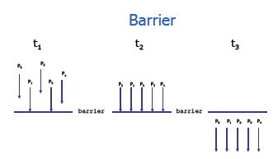

Slide 30
Blocking Message Passing Routines
MPI_Send
Basic blocking send operation. Routine returns only after the application buffer in the sending task is free for reuse.
MPI_Send (&buf,count,datatype,dest,tag,comm)

Slide 31
Blocking Message Passing Routines
MPI_Recv
Receive a message and block until the requested data is available in the application buffer in the receiving task.
MPI_Recv (&buf,count,datatype,source,tag,comm,&status)

Slide 32
Synchronous Send
MPI_Ssend
Synchronous blocking send: Send a message and block until the application buffer in the sending task is free for reuse and the destination process has started to receive the message.
MPI_Ssend (&buf,count,datatype,dest,tag,comm)

Slide 33
Buffered Send
MPI_Bsend
Buffered blocking send: permits the programmer to allocate the required amount of buffer space into which data can be copied until it is delivered. Insulates against the problems associated with insufficient system buffer space. Routine returns after the data has been copied from application buffer space to the allocated send buffer. Must be used with the MPI_Buffer_attach routine.
MPI_Bsend (&buf,count,datatype,dest,tag,comm)

Slide 34
Buffered send
MPI_Buffer_attach MPI_Buffer_detach
Used by programmer to allocate/deallocate message buffer space to be used by the MPI_Bsend routine. The size argument is specified in actual data bytes - not a count of data elements. Only one buffer can be attached to a process at a time.
MPI_Buffer_attach(&buffer,size)
MPI_Buffer_detach (&buffer,&size)

Slide 35
DEADLOCK(RECV-RECV)
int a,b,c;
int rank;
MPI_Status status;
……..
if(rank==0)
{
MPI_Recv(&b,1,MPI_INT,1,0,MPI_COMM_WORLD,&status);
MPI_Send(&a,1,MPI_INT,1,0,MPI_COMM_WORLD);
c=a+b/2;
}
else if(rank==1)
{
MPI_Recv(&a,1,MPI_INT,0,0,MPI_COMM_WORLD,&status);
MPI_Send(&b,1,MPI_INT,0,0,MPI_COMM_WORLD);
c=a+b/2;
}

Slide 36
DEADLOCK(TAG MISMATCH)
int a,b,c;
int rank;
MPI_Status status;
……..
if(rank==0)
{
MPI_Send(&a,1,MPI_INT,1,1,MPI_COMM_WORLD);
MPI_Recv(&b,1,MPI_INT,1,1,MPI_COMM_WORLD,&status);
c=a+b/2;
}
else if(rank==1)
{
MPI_Send(&b,1,MPI_INT,0,0,MPI_COMM_WORLD);
MPI_Recv(&a,1,MPI_INT,0,0,MPI_COMM_WORLD,&status);
c=a+b/2;
}

Slide 37
DEADLOCK(RANK MISMATCH)
int a,b,c;
int rank;
MPI_Status status;
……..
if(rank==0)
{
MPI_Send(&a,1,MPI_INT,2,1,MPI_COMM_WORLD);
MPI_Recv(&b,1,MPI_INT,2,1,MPI_COMM_WORLD,&status);
c=a+b/2;
}
else if(rank==1)
{
MPI_Send(&b,1,MPI_INT,0,0,MPI_COMM_WORLD);
MPI_Recv(&a,1,MPI_INT,0,0,MPI_COMM_WORLD,&status);
c=a+b/2;
}

Slide 38
DEADLOCK (COMMUNICATOR MISMATCH)
int a,b,c;
int rank;
MPI_Status status;
……..
if(rank==0)
{
MPI_Send(&a,1,MPI_INT,1,0,MYCOMMUNICATOR);
MPI_Recv(&b,1,MPI_INT,1,0,MPI_COMM_WORLD,&status);
c=a+b/2;
}
else if(rank==1)
{
MPI_Send(&b,1,MPI_INT,0,0,MPI_COMM_WORLD);
MPI_Recv(&a,1,MPI_INT,0,0,MPI_COMM_WORLD,&status);
c=a+b/2;
}

Slide 39
DEADLOCK(SELF BLOCKING SEND)
int a,b,c;
int rank;
MPI_Status status;
……..
if(rank==0)
{
MPI_Send(&a,1,MPI_INT,0,0,MPI_COMM_WORLD);
MPI_Recv(&b,1,MPI_INT,1,0,MPI_COMM_WORLD,&status);
c=a+b/2;
}
else if(rank==1)
{
MPI_Recv(&a,1,MPI_INT,0,0,MPI_COMM_WORLD,&status);
MPI_Send(&b,1,MPI_INT,0,0,MPI_COMM_WORLD);
c=a+b/2;
}

Slide 40
Synchronization
int MPI_Barrier(MPI_Comm comm)
#include "mpi.h"
#include <stdio.h>
int main(int argc, char *argv[]) {
int rank, nprocs;
MPI_Init(&argc,&argv);
MPI_Comm_size(MPI_COMM_WORLD,&nprocs);
MPI_Comm_rank(MPI_COMM_WORLD,&rank);
MPI_Barrier(MPI_COMM_WORLD);
printf("Hello, world. I am %d of %d\n", rank, nprocs);
MPI_Finalize();
return 0;
}

Slide 41
MPI: Global Communications
only come in blocking mode calls .
no tag provided, messages are matched by order of execution within the group.
intercommunicators are not allowed.
you cannot match these calls with P2P receives.

Slide 42
Collective Message Passing w/MPI
MPI_Bcast() Broadcast from root to all other processes
MPI_Reduce() Combine values on all processes to single val
MPI_Scatter() Scatters buffer in parts to group of processes
MPI_Gather() Gather values for group of processes
MPI_Alltoall() Sends data from all processes to all processes

Slide 43
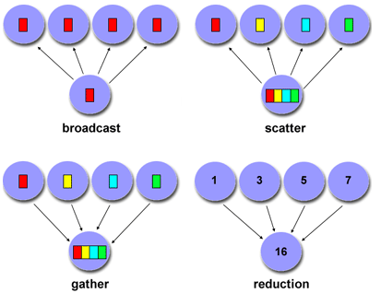
Collective Communication

Slide 44
Collective Communication Routines
Scope:Collective communication routines must involve all processes within the scope of a communicator. All processes are by default, members in the communicator MPI_COMM_WORLD.
Unexpected behavior, including program failure, can occur if even one task in the communicator doesn't participate.
It is the programmer's responsibility to ensure that all processes within a communicator participate in any collective operations.

Slide 45
Types of Collective Operations:
Synchronization - processes wait until all members of the group have reached the synchronization point.
Data Movement - broadcast, scatter/gather, all to all.
Collective Computation (reductions) - one member of the group collects data from the other members and performs an operation (min, max, add, multiply, etc.) on that data.

Slide 46
Collective Communication Routines
MPI_Barrier
Synchronization operation. Creates a barrier synchronization in a group. Each task, when reaching the MPI_Barrier call, blocks until all tasks in the group reach the same MPI_Barrier call. Then all tasks are free to proceed.
MPI_Barrier (comm)

Slide 47
Broadcast
MPI: Broadcast (One-to-all)
int MPI_Bcast(void *buffer, int count, MPI_Datatype datatype, int root, MPI_Comm comm);
broadcasts a message from process with rank root in comm to all other processes in comm.
One process (root) sends data to all the other processes in the same communicator
Must be called by all the processes with the same arguments

Slide 48
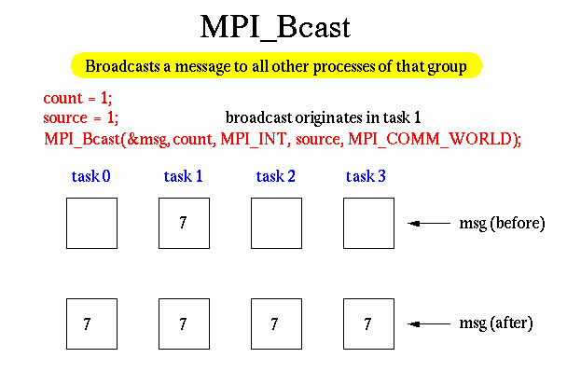
Collective Communication Routines

Slide 49
Collective Communication Routines
MPI_Bcast
Data movement operation. Broadcasts (sends) a message from the process with rank "root" to all other processes in the group.
MPI_Bcast (&buffer,count,datatype,root,comm)

Slide 50
MPI: Reduction Operations
Perform global reduce operations across all members of a group.
Many predefined operations come with MPI.
Ability to define your own operations.

Slide 51
Reduction
MPI: Reduce (all-to-one reduction operation )
int MPI_Reduce(void *sendbuf, void *recvbuf, int count, MPI_Datatype datatype, MPI_Op op, int root, MPI_Comm comm)
One process (root) collects data to all the other processes in the same communicator, and performs an operation on the data (i.e combines elements provided by input buffer of each process in the group using operation op.)
MPI_SUM, MPI_MIN, MPI_MAX, MPI_PROD, logical AND, OR, XOR, and a few more
returns combined value in the output buffer of process with rank root.
MPI_Op_create(): User defined operator

Slide 52
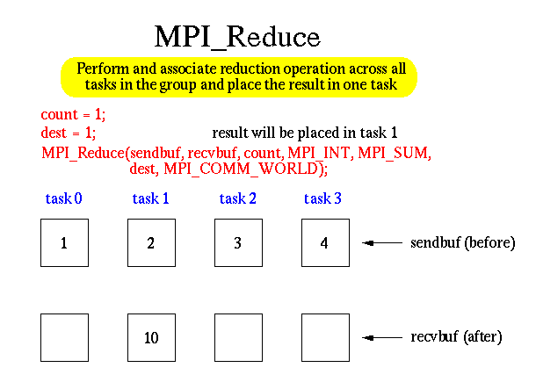

Slide 53
Collective Communication Routines
MPI REDUCTION Operation
MPI_MAX
MPI_MIN
MPI_SUM
MPI_PROD
MPI_LAND
MPI_BAND
MPI_LOR
MPI_BOR
MPI_LXOR
MPI_BXOR
MPI_MAXLOC
MPI_MINLOC

Slide 54
1. Write an MPI program to read n elements in root process. Calculate sum in each process and print final sum in root process. Use reduce

Slide 55
MPI: Scatter
int MPI_Scatter(void *sendbuf, int sendcount, MPI_Datatype sendtype, void *recvbuf, int recvcount, MPI_Datatype recvtype, int root, MPI_Comm comm)
inverse to MPI_Gather.
sendbuf is ignored by all non-root processes.

Slide 56
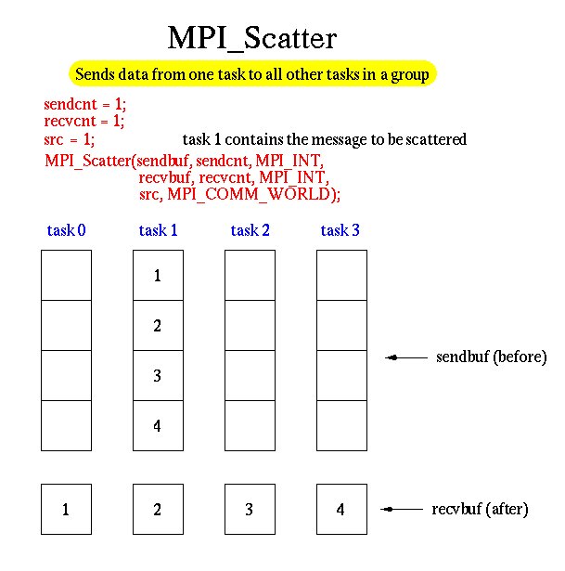

Slide 57
Gather
MPI: Gather
int MPI_Gather(void *sendbuf, int sendcnt, MPI_Datatype sendtype, void *recvbuf, int recvcnt, MPI_Datatype recvtype, int root, MPI_Comm comm)
One process (root) collects data to all the other processes in the same communicator (i.e each process in comm (including root itself) sends its sendbuf to root.)
the root process receives the messages in recvbuf in rank order.
Must be called by all the processes with the same arguments

Slide 58
Collective Communication Routines
MPI_Scatter
Data movement operation. Distributes distinct messages from a single source task to each task in the group.
MPI_Scatter (&sendbuf,sendcnt,sendtype,&recvbuf, recvcnt,recvtype,root,comm)

Slide 59
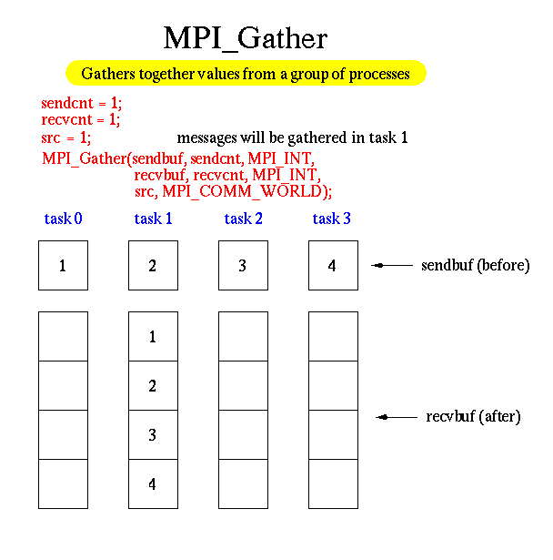

Slide 60
Collective Communication Routines
MPI_Gather
Data movement operation. Gathers distinct messages from each task in the group to a single destination task. This routine is the reverse operation of MPI_Scatter.
MPI_Gather (&sendbuf,sendcnt,sendtype,&recvbuf, recvcount,recvtype,root,comm)

Slide 61
Gather to All
MPI: Allgather
int MPI_Allgather(void *sendbuf, int sendcnt, MPI_Datatype sendtype, void *recvbuf, int recvcnt, MPI_Datatype recvtype, MPI_Comm comm)
All the processes collects data to all the other processes in the same communicator (i.e similar to MPI_Gather except now all processes receive the result.)
recvbuf is NOT ignored.
Must be called by all the processes with the same arguments
MPI also provides the MPI_Allgather function in which the data are gathered at all the processes.

Slide 62
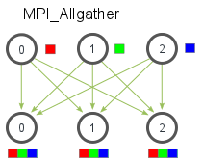
MPI_Allgather
MPI_Allgather( void* send_data, int send_count, MPI_Datatype send_datatype,
void* recv_data, int recv_count, MPI_Datatype recv_datatype,
MPI_Comm communicator)

Slide 63
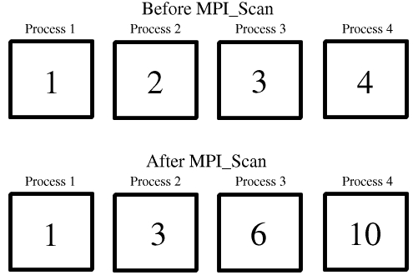
MPI_Scan
MPI_Scan( void *sendbuf, void *recvbuf, int count, MPI_Datatype datatype,
MPI_Op op, MPI_Comm comm );

Slide 64
MPI: Alltoall
int MPI_Alltoall(void *sendbuf, int sendcount, MPI_Datatype sendtype, void *recvbuf, int recvcount, MPI_Datatype recvtype, MPI_Comm comm)
Each process sends distinct data to each of the receivers.
the j^{th} block sent from process i is received by process j and placed in the i^{th} block of recvbuf.

Slide 65
Collective Communication Operations
To compute prefix-sums, MPI provides:
int MPI_Scan(void *sendbuf, void *recvbuf, int count, MPI_Datatype datatype, MPI_Op op,
MPI_Comm comm)

Slide 66
TIME CALCULATION:
..
MPI_Wtime
Returns an elapsed time on the calling processor.
double MPI_Wtime( void );
Return value
Time in seconds.
Notes:
..The elapsed (wall-clock) time between two points in an MPI program can be computed using MPI_Wtime

Slide 67
#include "mpi.h" #include <windows.h> #include <stdio.h> #include<conio.h>
int main( int argc, char *argv[] ) { double t1, t2; MPI_Init( ………… );
t1 = MPI_Wtime();
Sleep(1000);
t2 = MPI_Wtime();
printf("MPI_Wtime measured a 1 second sleep to be:
%1.2f\n", t2-t1);
fflush(stdout);
getch(); MPI_Finalize( ); return 0; }

Slide 68
Handling MPI Errors
The error handler is called every time an MPI error is detected within the communicator.
There is a predefined error handler, which is called
MPI_ERRORS_RETURN.
error handler can be used by calling function
MPI_Errhandler_set.
MPI_Errhandler_set(MPI_COMM_WORLD, MPI_ERRORS_RETURN);
Once you've done this in your MPI code, the program will no longer abort on having detected an MPI error, instead the error will be returned and you will have to handle it.

Slide 69
Handling MPI Errors (Contd..)
The returned error code is implementation specific.
The only error code that MPI standard itself defines is MPI_SUCCESS, i.e., no error.
MPI standard defines so called error classes.
Every error code, must belong to some error class, and the error class for a given error code can be obtained by calling function MPI_Error_class.
Error classes can be converted to comprehensible error messages by calling MPI_Error_string.
Meaning of an error code can be extracted by calling function MPI_Error_string.

Slide 70
#include "mpi.h"
#include <stdio.h>
#include<conio.h>
void ErrorHadler(int error_code)
{
}
int main(int argc,char *argv[])
{
int C=3;
int numtasks, rank, len, error_code;
error_code = MPI_Init(&argc,&argv);
MPI_Errhandler_set(MPI_COMM_WORLD, MPI_ERRORS_RETURN);
MPI_Comm_rank(MPI_COMM_WORLD,&rank);
error_code = MPI_Comm_size(C,&numtasks);
ErrorHadler(error_code);
printf ("Number of tasks= %d My rank= %d \n", numtasks,rank);
MPI_Finalize();
}

Slide 71
#include "mpi.h"
#include <stdio.h>
#include<conio.h>
void ErrorHadler(int error_code)
{
if (error_code != MPI_SUCCESS)
{
char error_string[BUFSIZ];
int length_of_error_string, error_class;
MPI_Error_class(error_code, &error_class);
MPI_Error_string(error_class, error_string, &length_of_error_string);
fprintf(stderr, " %s %d\n", error_string, length_of_error_string);
MPI_Error_string(error_code, error_string, &length_of_error_string);
fprintf(stderr, "HELLO_ERRORCODE %s\n", error_string);
}
}
Notes:
Every error code, must belong to some error class, and the error class for a given error code can be obtained by calling function MPI_Error_class.
Error classes can be converted to comprehensible error messages by calling MPI_Error_string.
Error_string is user friendly error message such as invalid error ex: invalid communicator.

Slide 72
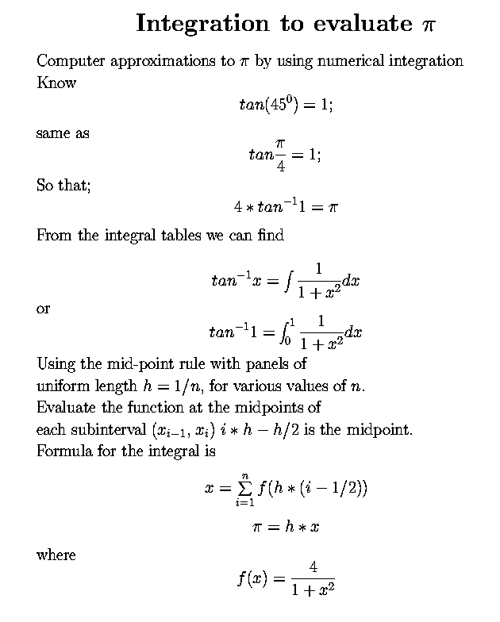
Approximation of Pi Compute π value using p processors.

Slide 73
Example: PI in C -1
#include "mpi.h"
#include <math.h>
int main(int argc, char *argv[])
{ int done = 0, n, myid, numprocs, i, rc; double PI25DT = 3.141592653589793238462643; double mypi, pi, h, sum, x, a; MPI_Init(&argc,&argv); MPI_Comm_size(MPI_COMM_WORLD,&numprocs); MPI_Comm_rank(MPI_COMM_WORLD,&myid); while (!done) { if (myid == 0) { printf("Enter the number of intervals: (0 quits) "); scanf("%d",&n); } MPI_Bcast(&n, 1, MPI_INT, 0, MPI_COMM_WORLD); if (n == 0) break;

Slide 74
Example: PI in C - 2
h = 1.0 / (double) n; sum = 0.0; for (i = myid + 1; i <= n; i += numprocs) { x = h * ((double)i - 0.5); sum += 4.0 / (1.0 + x*x); } mypi = h * sum; MPI_Reduce(&mypi, &pi, 1, MPI_DOUBLE, MPI_SUM, 0, MPI_COMM_WORLD); if (myid == 0) printf("pi is approximately %.16f, Error is %.16f\n", pi, fabs(pi - PI25DT)); } MPI_Finalize();
return 0;
}

Slide 75
References
https://computing.llnl.gov/tutorials/mpi/
Su, Francis E., et al. "Taylor-made Pi." Math Fun Facts. <http://www.math.hmc.edu/funfacts>.

